Slide 1

Data Visualization:
past, present, future

Slide 2
William Playfair, 1786 - 1801

Slide 3
John Tukey, 1969
http://stat-graphics.org/movies/prim9.html

Slide 4
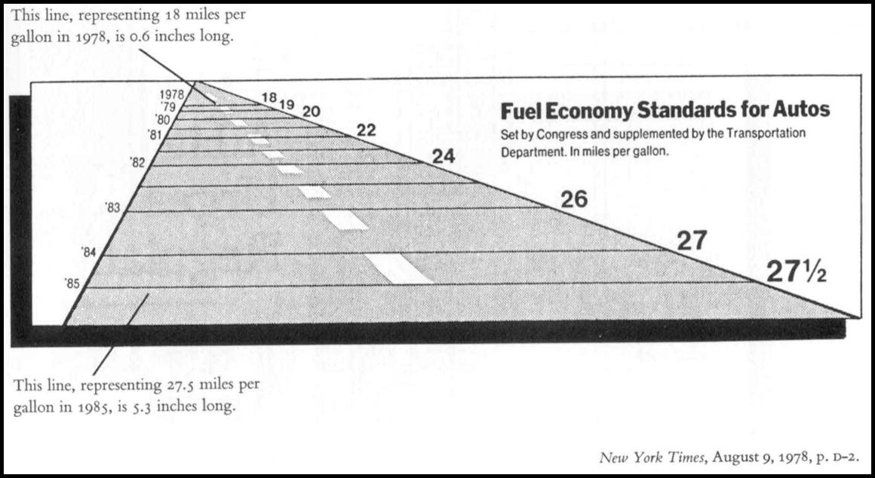

Slide 5
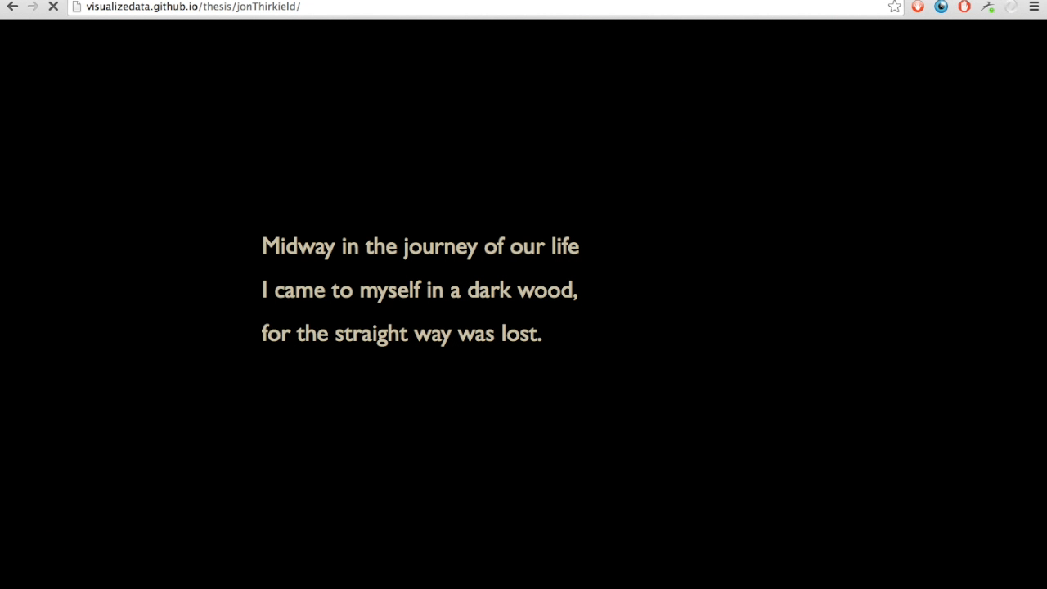

Slide 6
rendering

Slide 7
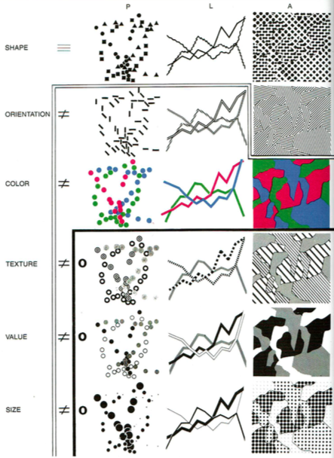
Bertin, Jacques, and William J. Berg. 2010. Semiology of Graphics: Diagrams, Networks, Maps. 1st ed. Redlands, Calif: ESRI Press : Distributed by Ingram Publisher Services.

Slide 8
Hadley Wickham’s “A Layered Grammar of Graphics”
data | aesthetic mapping | geom | stat | scale | coord | facet
http://ggplot2.org/
http://vita.had.co.nz/papers/layered-grammar.html

Slide 9
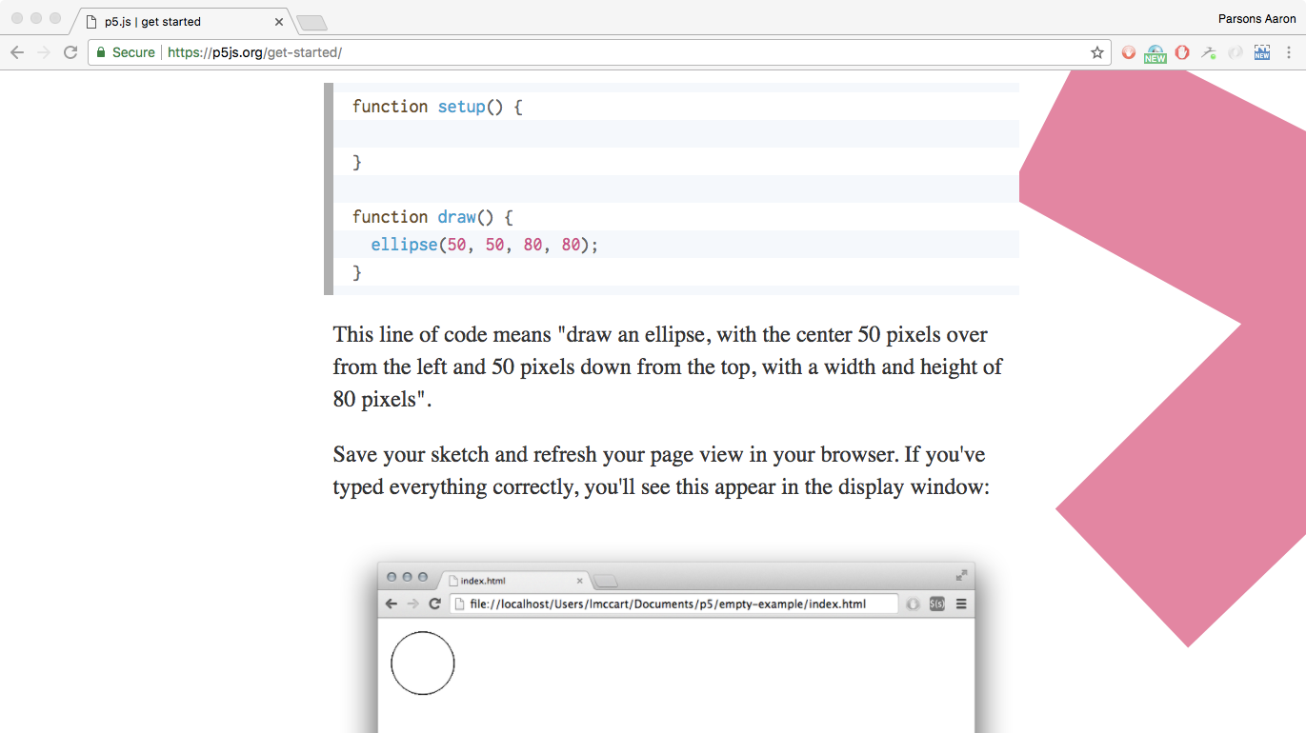

Slide 10
Observing point,
Line, area in art
http://www.tate.org.uk/art/artworks/stephenson-flaxman-understudy-t01943
https://www.moma.org/collection/works/92947?locale=en
http://www.tate.org.uk/whats-on/tate-modern/exhibition/malevich
https://www.youtube.com/watch?v=they7m6YePo

Slide 11
computation

Slide 12
The designer of the future has to become a database designer, a meta-designer, not designing objects, but shaping a design space in which unskilled users can access user-friendly environments in which they can design their own objects.
Jos de Mul in Redesigning Design

Slide 13
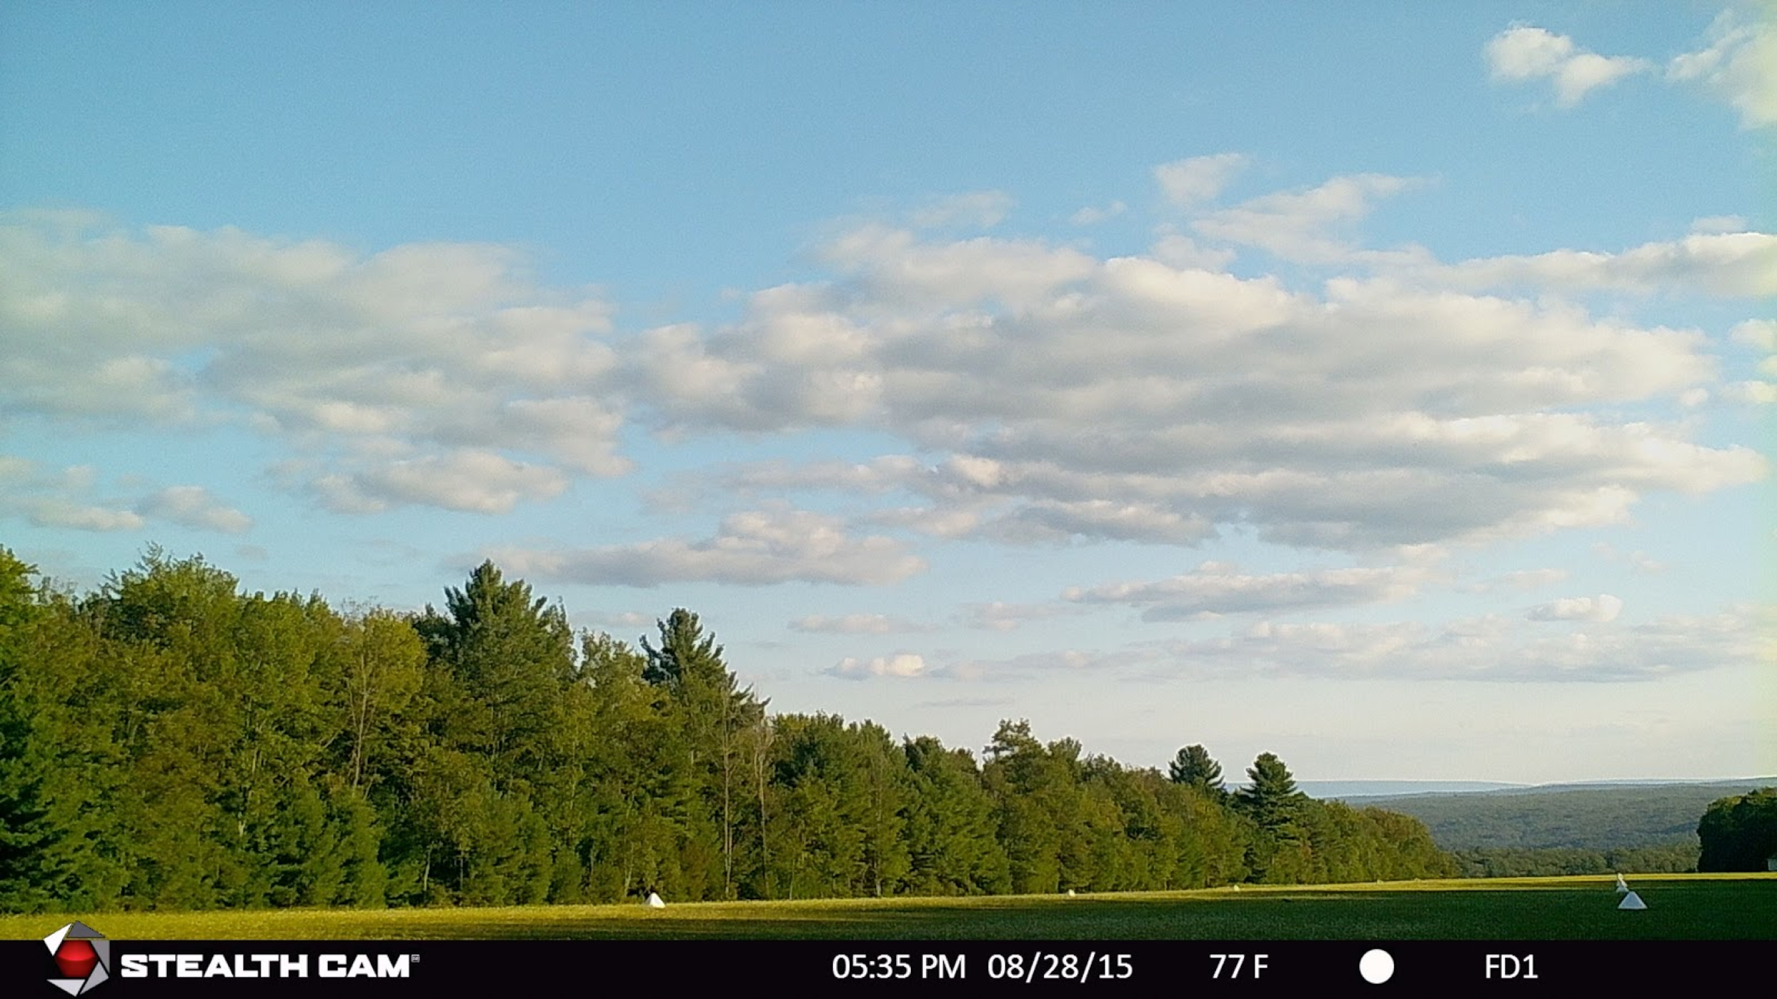

Slide 14
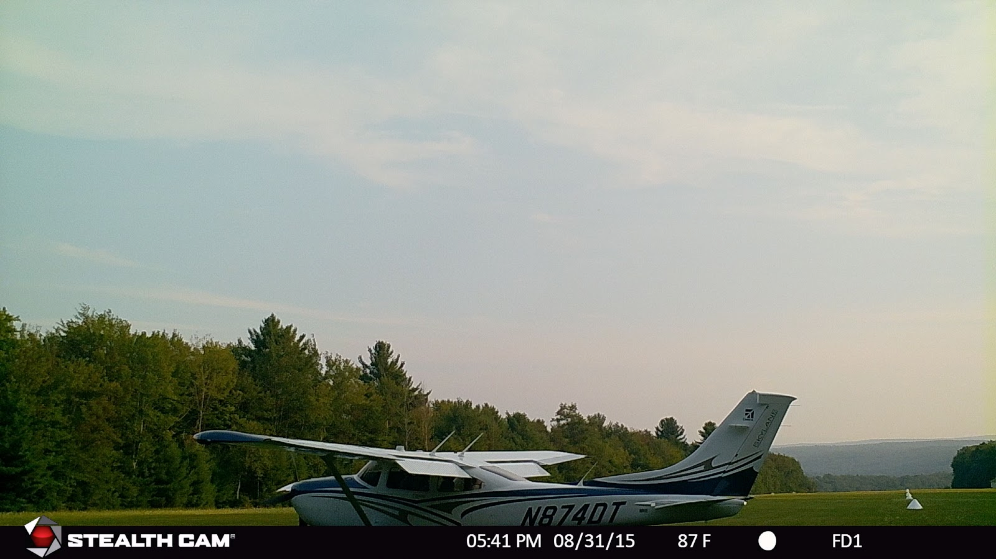

Slide 15
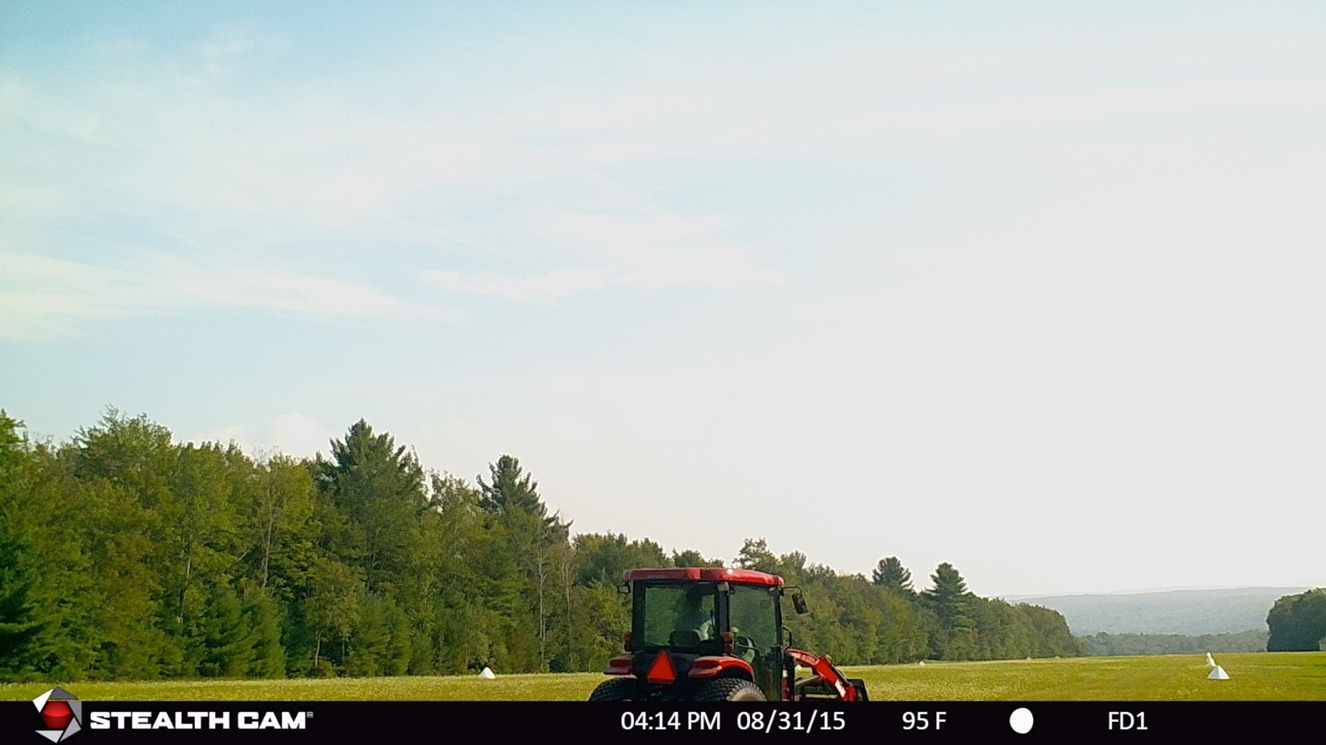

Slide 16
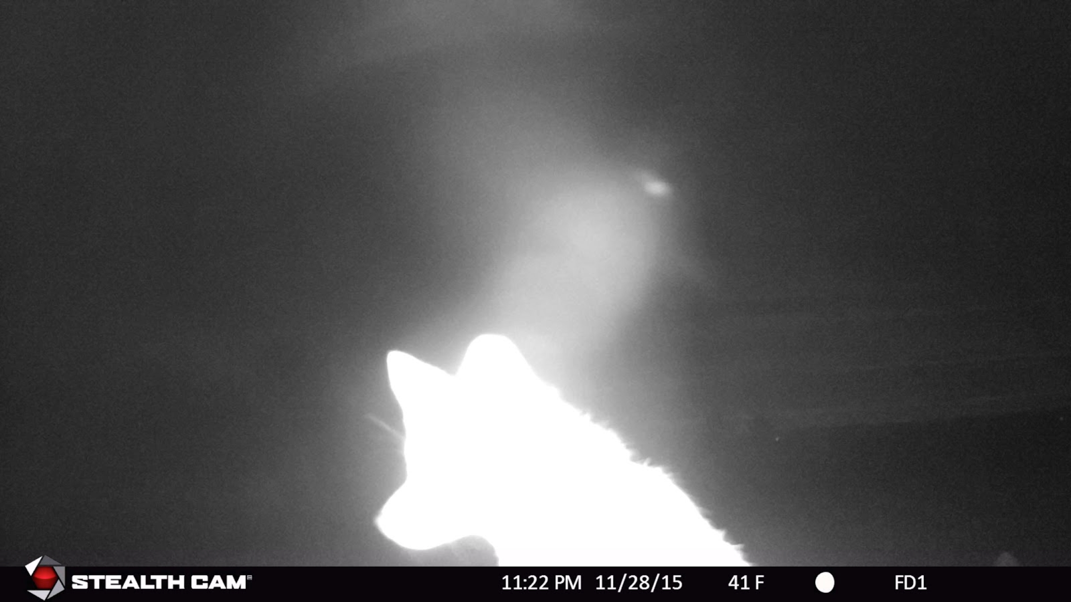

Slide 17
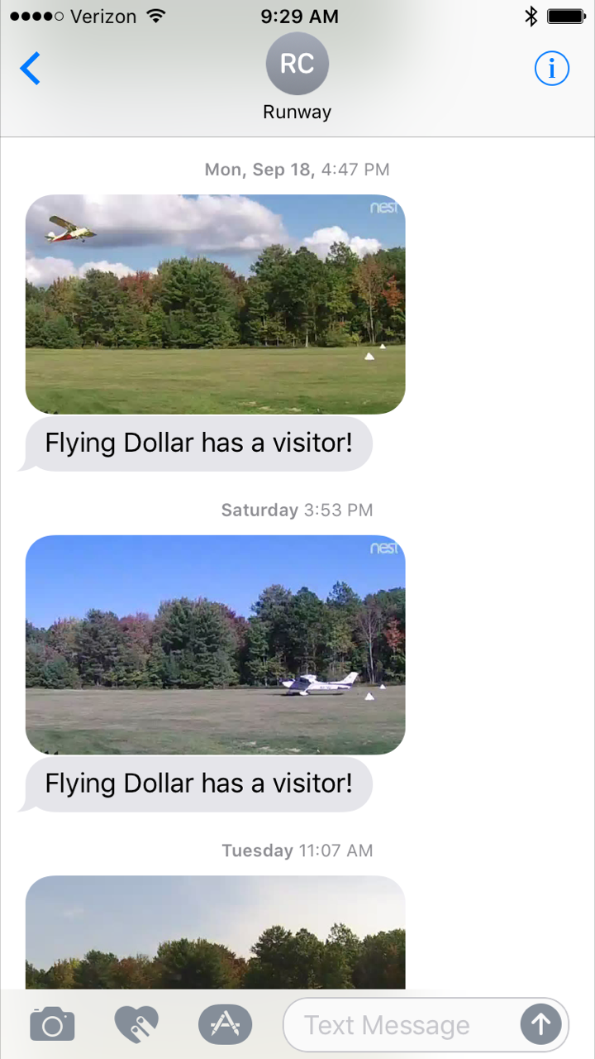
30 frames / sec = 2.6 millions frames / day

Slide 18
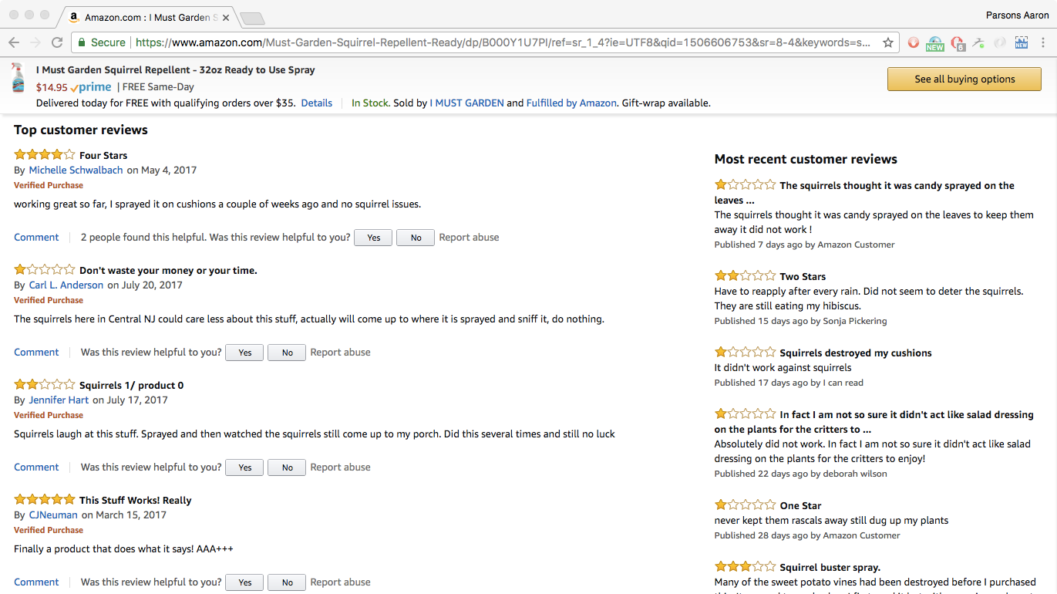

Slide 19
visualizing uncertainty
& measuring perception

Slide 20
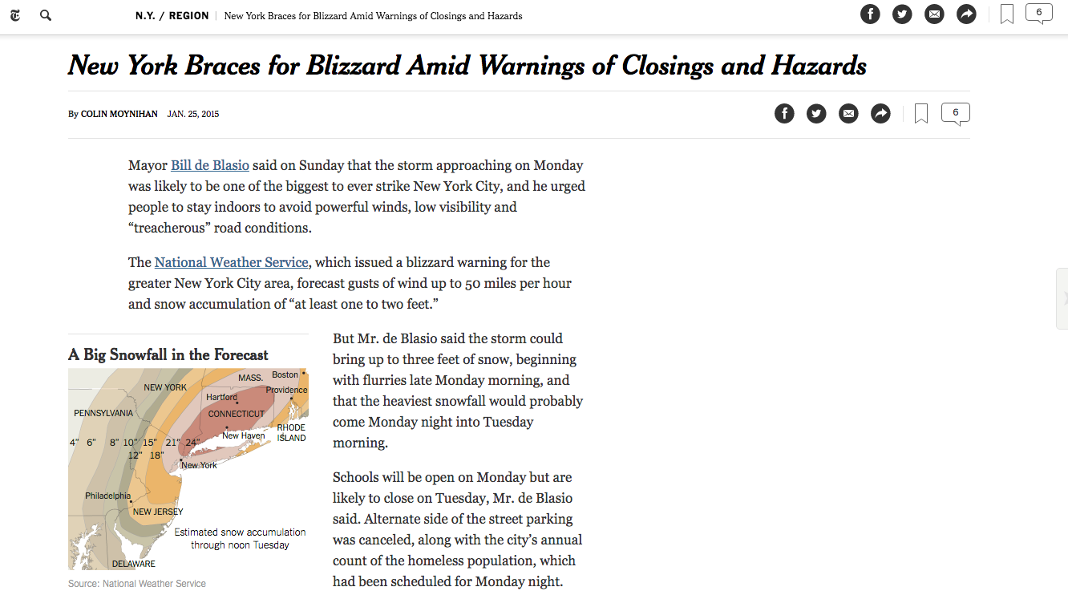

Slide 21
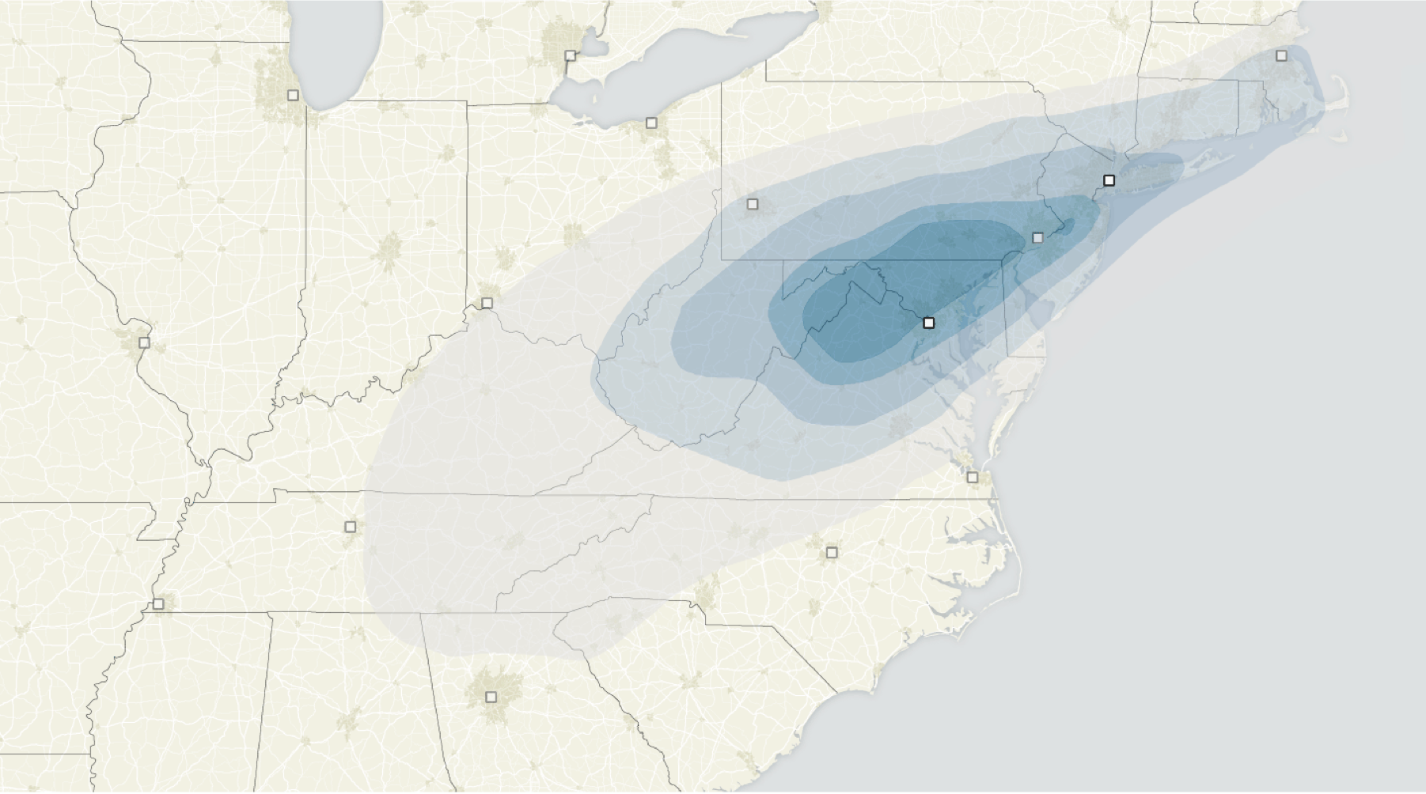
New York Times
Blizzard (forecast), January 2015

Slide 22
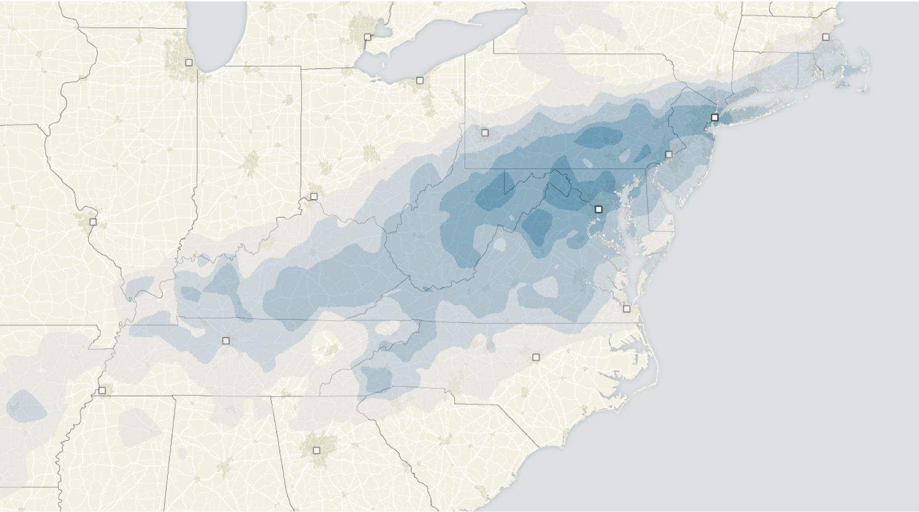
New York Times
Blizzard (actual), January 2015

Slide 23
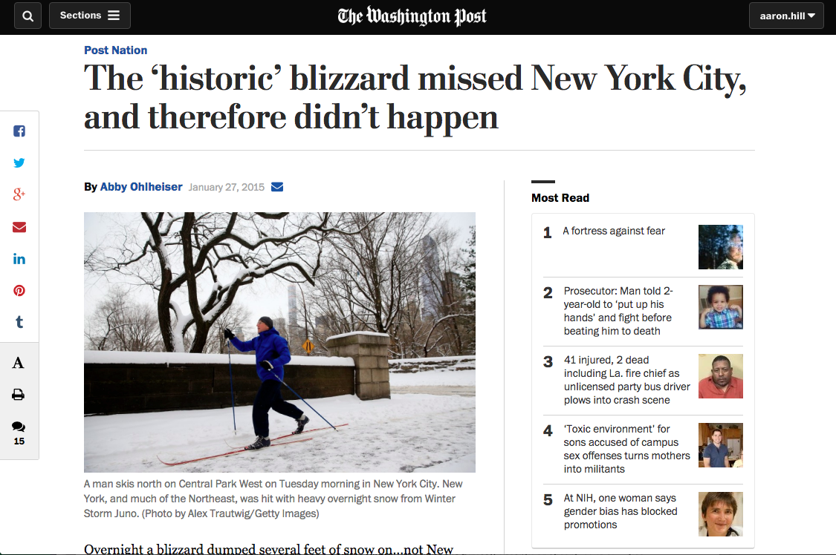

Slide 24
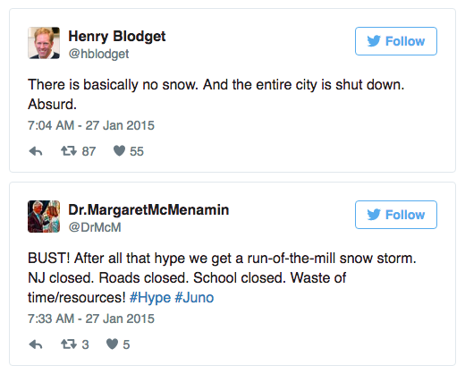
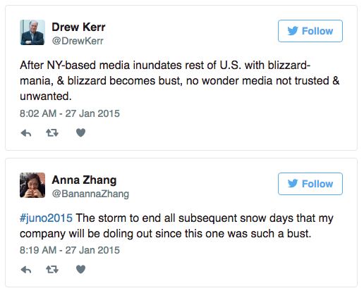

Slide 25
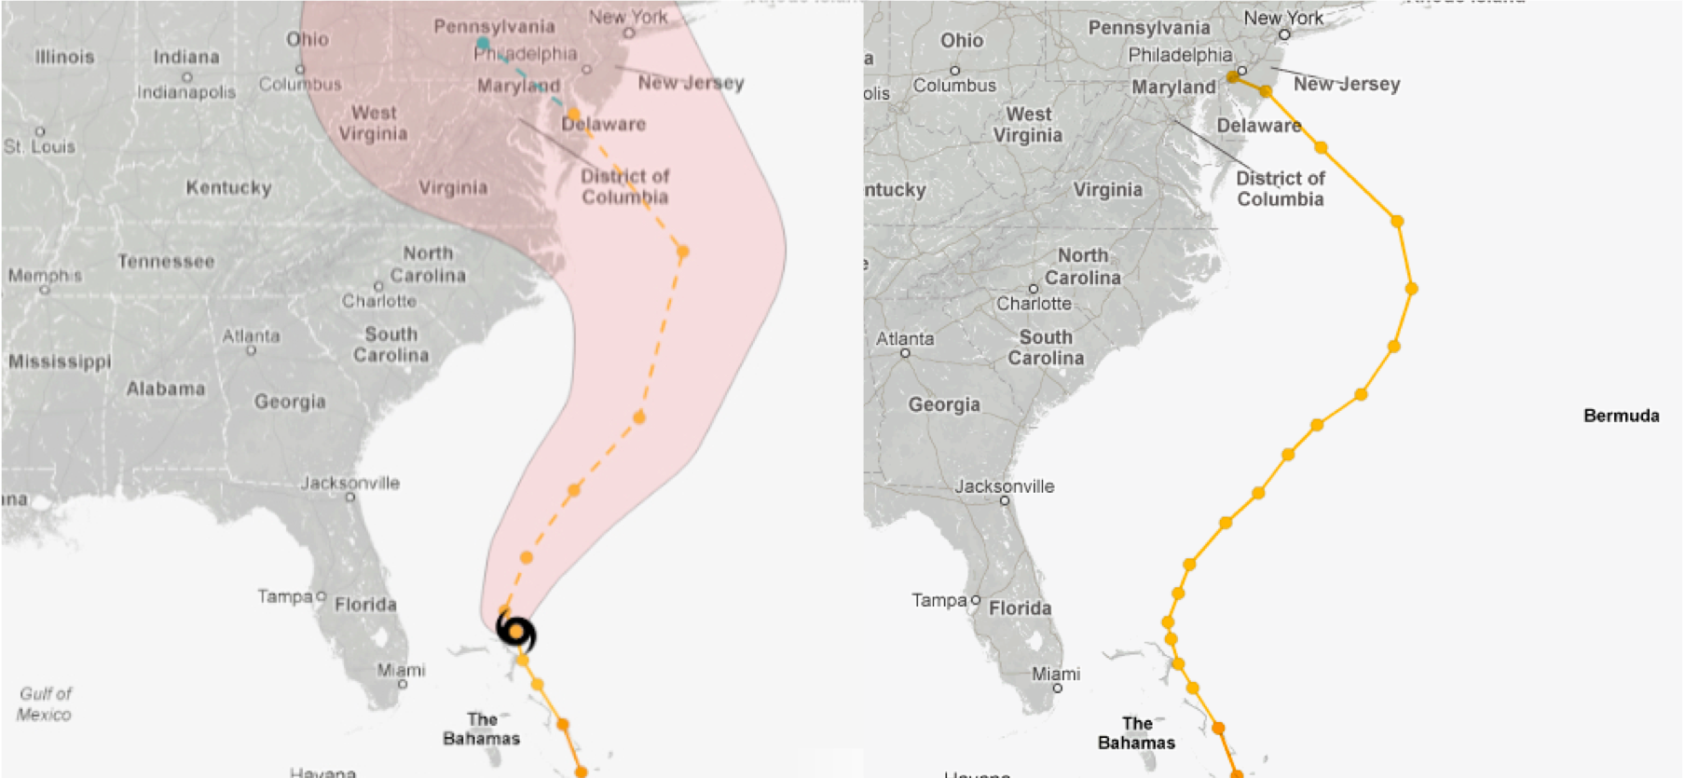
New York Times
Hurricane Sandy

Slide 26
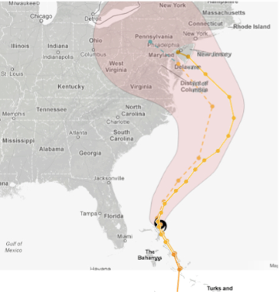
New York Times

Slide 27
Cleveland, William S., and Robert McGill. "Graphical perception: Theory, experimentation, and application to the development of graphical methods." Journal of the American statistical association 79, no. 387 (1984): 531-554.

Slide 28
Data Visualization:
past, present, future

